Slide 1
Vegetable image classification
Rafif Dwiputra

Slide 2
About vegetable classification
From vegetable production to delivery, several common steps are operated manually. Like picking, and sorting vegetables. Therefore, we decided to solve this problem using deep neural architecture, by developing a model that can detect and classify vegetables. That model can be implemented in different types of devices and can also solve other problems related to the identification of vegetables, like labeling the vegetables automatically without any need for human work.

Slide 3
OBJECTIVE
To classification vegetable based on image
DATASET
The dataset is used to classification vegetable, The dataset used contains 15 different types of vegetables.

Slide 4
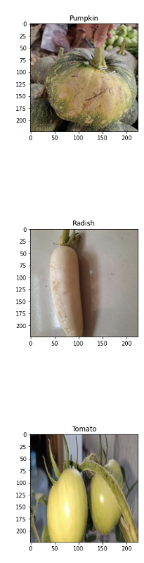
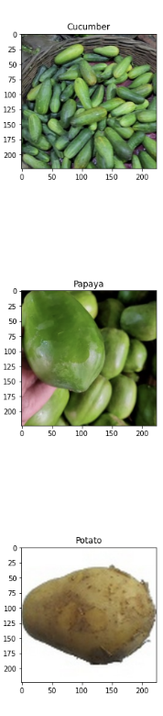
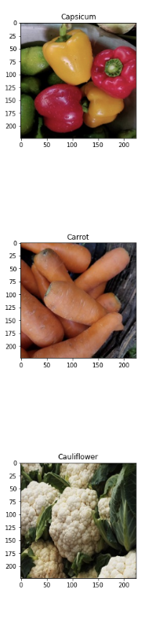
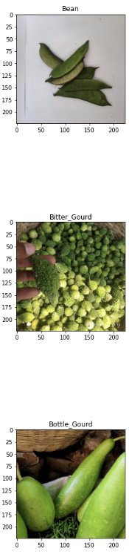
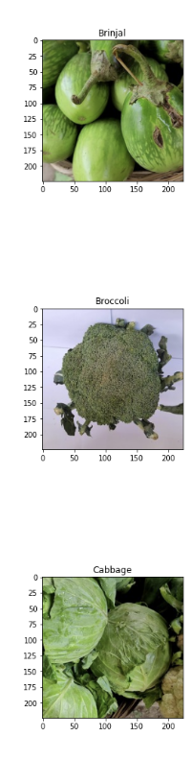
eda
The size of each image is 200 x 200
- The colors of each image are predominantly green and white.
- In some categories, such as carrot and capsicum, it has orange and red colors.

Slide 5
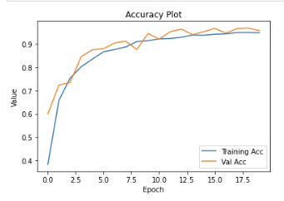
model
It can be seen that the Model is already very good, with each additional epoch its accuracy increases. Both training and val accuracy are related, it can be concluded that this model is not overfit.

Slide 6
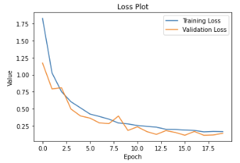
model
With each additional epoch, the loss gets less and less. Both training loss and val loss are related, it can be concluded that this model is not overfit.

Slide 7
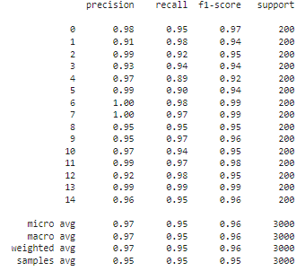
Classification report sequential api
From the f1 scores of all categories it can be seen that the average value is 0.96, which is good enough for a model.

Slide 8
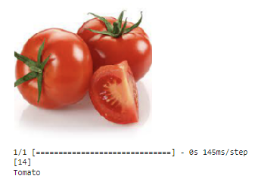
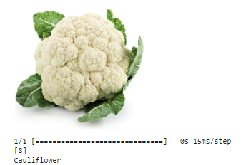
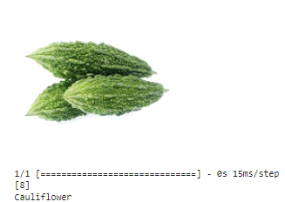
Model inference

Slide 9
SUMMARY
At the time of testing by uploading images, the model succeeded in predicting 2 of the 3 images correctly, from these results it can be concluded that there is still data that cannot be predicted correctly, several things that can affect this prediction are the ambiguity of the colors in vegetables and the shape of vegetables are still similar to one another which makes the model misread the colors on vegetables and the shape of vegetables which are almost similar to one another, because of that we are fully aware that there are still many things that need to be improved.

Slide 10
THANK YOU

